Slide 1


Centralized Reporting Team?
Why
EMEA SSC

Slide 2




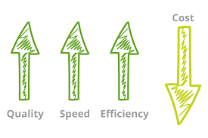
We are using
best reporting practices across Sitel countries while sharing our knowledge and responsibilities inside the team which leads to
better quality and
data consistency
All this while being
Cost Efficient

Slide 3








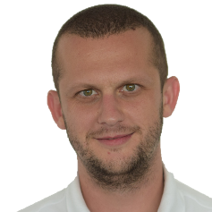
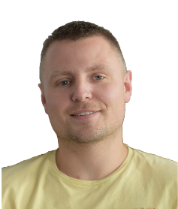
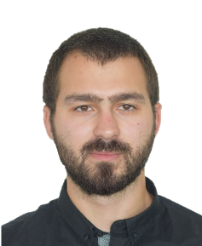
Meet The Team
Our skillset
Georgi Tsatsev
Head of Reporting
MS Excel & Access DB proficiency
Dashboard development and report automations
VBA/VBS
SAP Business Objects reports design
MS SQL, SSMS, ETL
PowerShell
Avaya/CMS
Business analysis
PowerPoint
Nikolay Lubenov
Team Leader
Boyan Simeonov
Martin Shunanov
Georgi Korfonozov
Vladin Iordanov
Reporting Analyst
Reporting Analyst
Reporting Analyst
Reporting Analyst
Lyulina Gibinska
Ivan Donchev
Ilian Kukov
Yavor Filipov
Reporting Analyst
Reporting Analyst
Reporting Analyst
Reporting Analyst

Slide 4


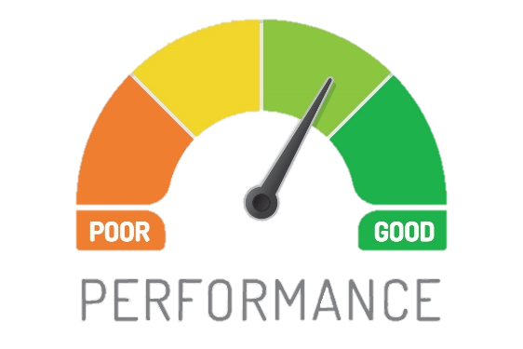





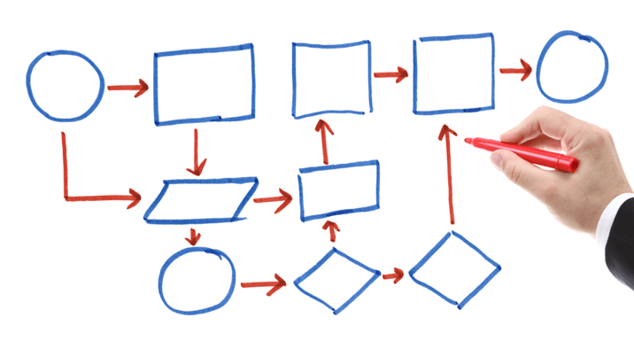

What We Do?
Internal & Client Reporting
Agent Reports
Add-hoc Reports
Business Analysis & Insights
Tools Development & Process Improvement
Automation Projects
Site Support

Slide 5
Who do we work with?
Country Managers
Site Directors
Operations Managers
WFM Teams
HR Managers
Recruitment Mangers
Payroll Management
Operations
HR
Quality Managers
REPORTING
IT Teams
Global Data Warehouse Teams
COR Mapping
Quality
IT
TEAM
Finance
PIPM
FP&A Teams
Accounting
Process Improvement Teams
www.free-powerpoint-templates-design.com

Slide 6
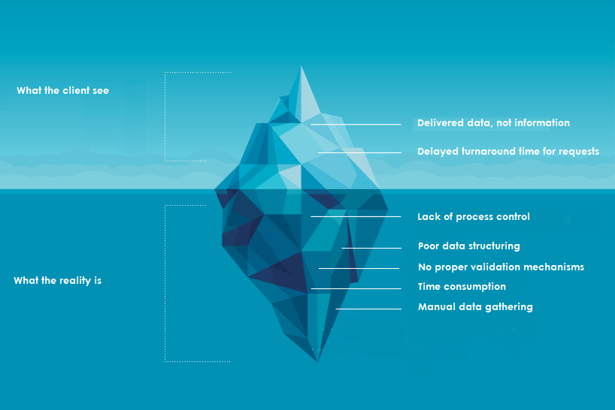
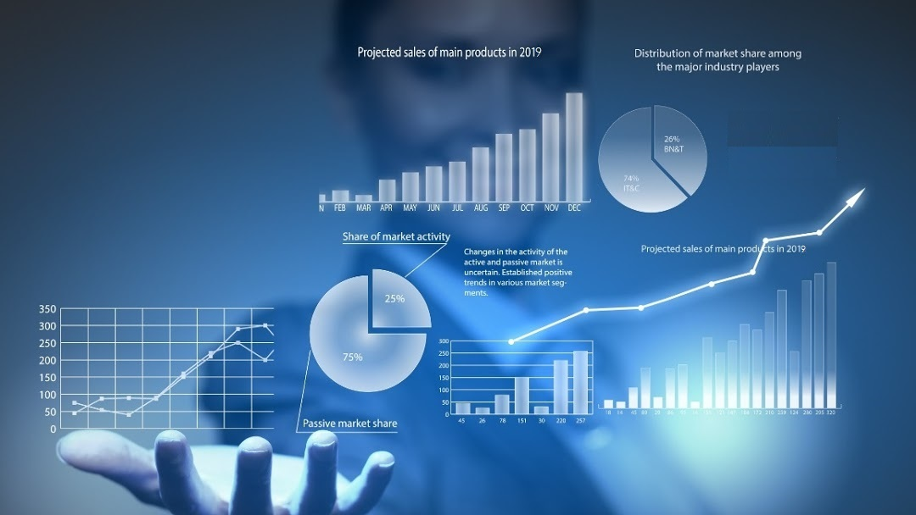
Before report centralization
After report centralization
Reporting handled locally by OMs/Analysts with no transparency and alignment between multi location clients
Lack of proper process documentation and backup strategy in place
Reporting concentrated in one person and completely relying on his knowledge
Manual data gathering process due to lack of enough technical understanding
Reports consisting data only rather than information
Time consuming process of gathering information in one place from different regions and sources
Centralized team overseeing multi-site reporting
Proper documentation and working instructions allowing easier handover process and backup to guarantee business continuity
Team with similar skill set and knowledge
SQL Server integration resulting in more optimal data structure, larger capacity, less execution time and better data integrity
Repetitive reporting tasks are offloaded from ops teams and automations are put in place
Continuous alignment between centralized units and local teams
Applied best reporting practices leading to better turnaround to client requests and proper data setup
Easy to use dashboards and possibility to slice and dice the data in a couple of clicks
Technical expertise shared between the team members, applying the most appropriate solution to the specific client requirements

Slide 7

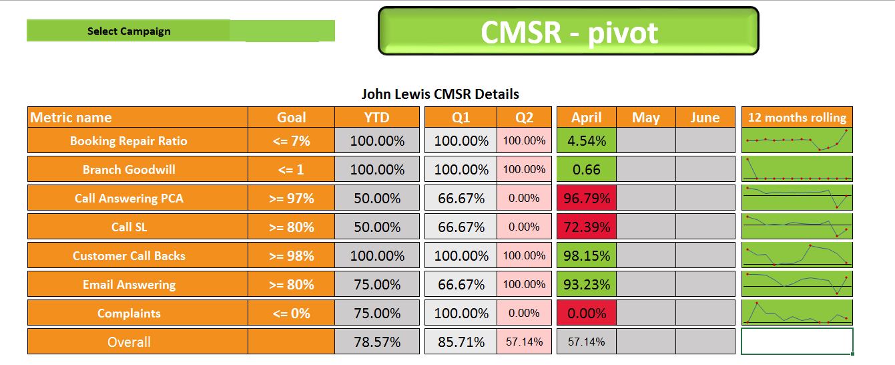
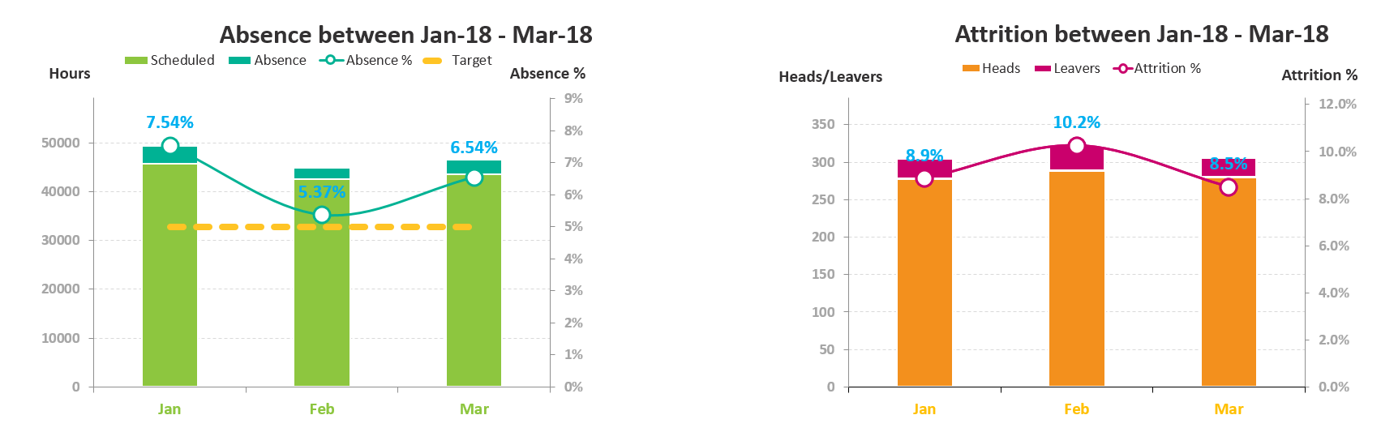

Site Reports
Site Tracker
Site tracker is a one stop shop report for the site performance against targets including:
Visualizations of various metrics such as trends related to the Absenteeism , Attrition and CMSR
YTD trends of the various clients’ and sites’ metrics
Ready to use charts for MBR and QBR presentations

Slide 8

Site Reports
Invoicing Data Automation and Validation
The reporting team can help gather and transform the raw data to meaningful information applying various validations checks to ensure invoice accuracy
Automation of the end to end process of invoicing preparation ensuring quicker completions to meet deadlines

Slide 9
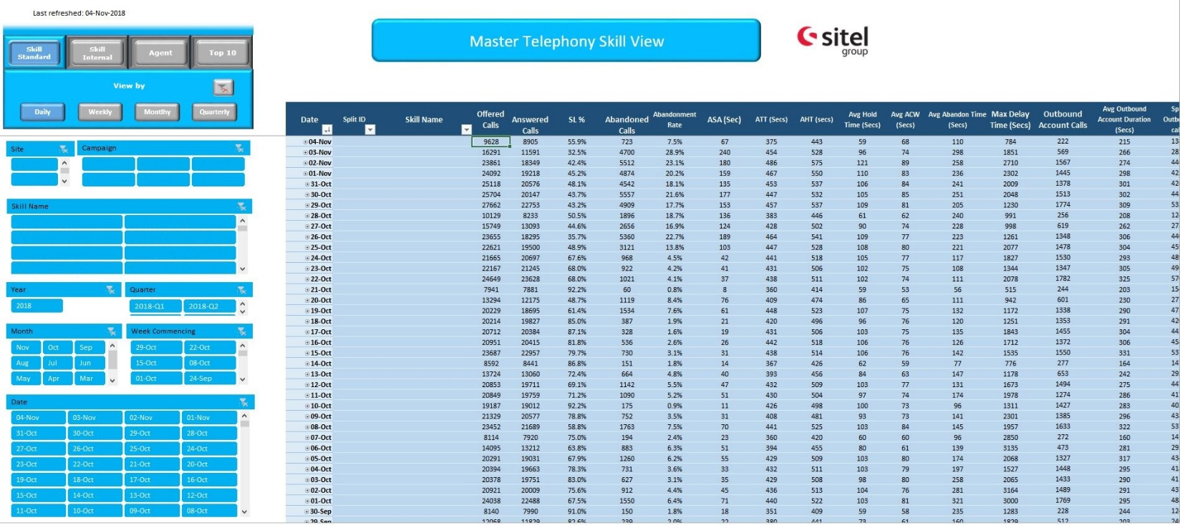
Campaign Reports
Telephony Dashboard
A consolidated report across multiple sites holding all key telephony reporting metrics
(AHT, SLA, Abn. Rate)
Several views are available to help you analyze your workload: by Client, Skill and Agent for daily/weekly/monthly/ quarterly time period
Highlight Top/Low 10 agents performance based on chosen criteria

Slide 10

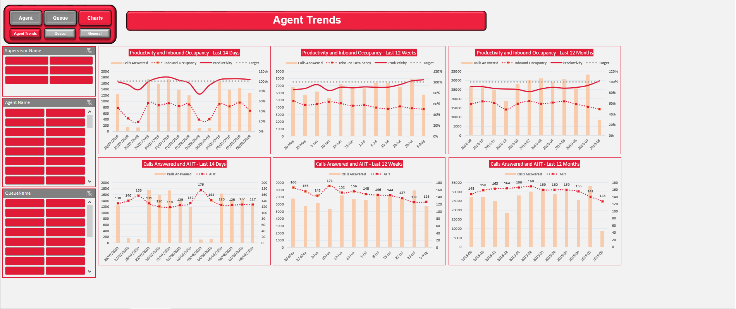
Client Reports
Client Reports
Updated daily
Contains different information based on the client’s expectations and needs: Inbound, Outbound, CSAT, Conversion Rates, Non-Call Data
Have multiple aggregated views available with the option to slice and dice the data as necessary

Slide 11
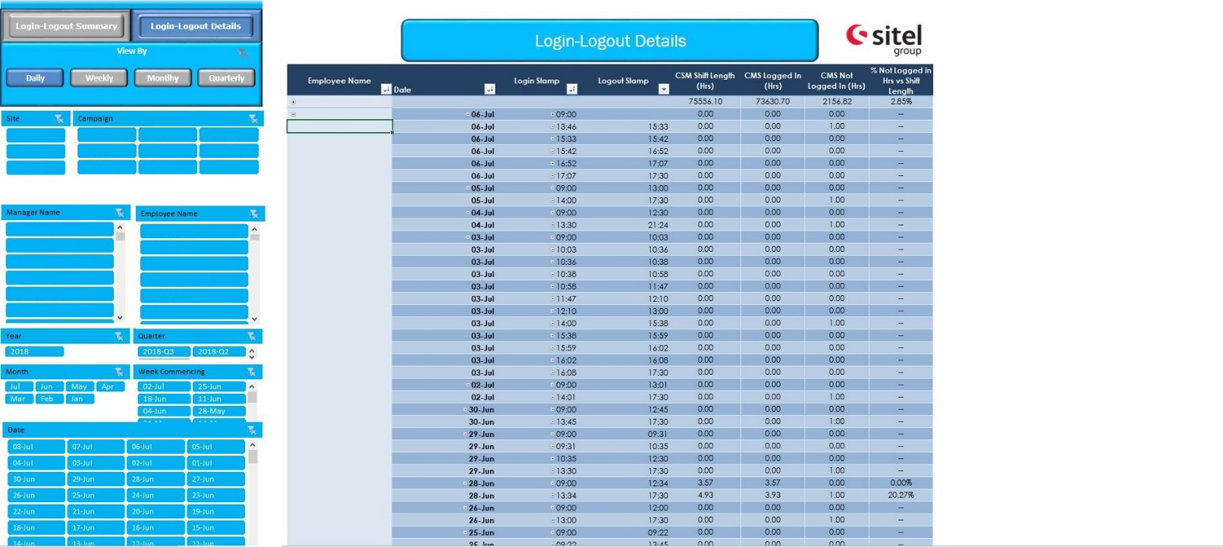
People Management
Agent Adherence Report
Updated daily
Monitor agent shifts adherence with one click
Have multiple views: daily, weekly, monthly, quarterly
Track logged in hours, shift lengths, breaks, time stamps and productive hours
Daily monitoring of Bill-to-Pay

Slide 12

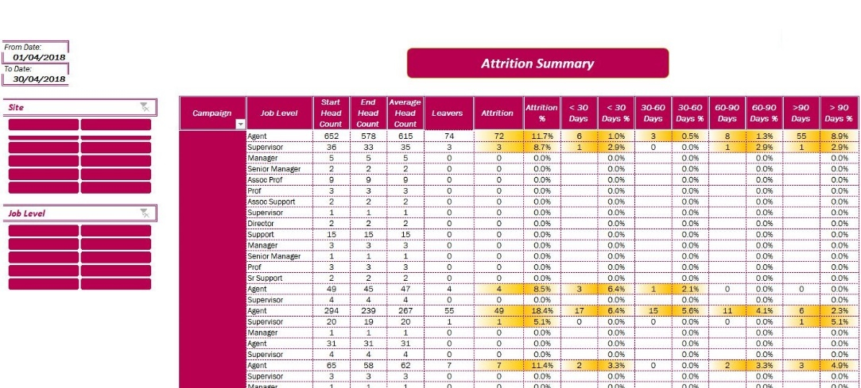
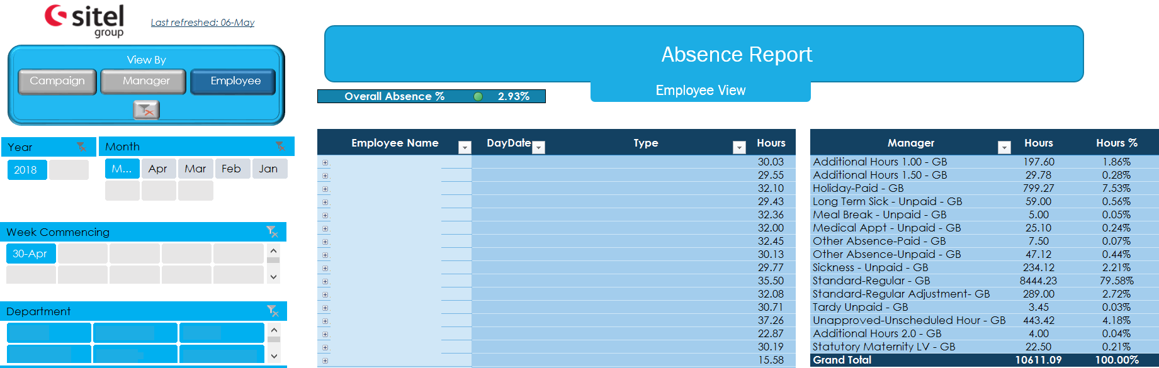
People Management
Attrition Report
Absence Report
Easy to analyze MoM and YoY trends
Employees tenure analysis
Ability to slice and dice the data by client, team and manager
Monitor reasons for leaving
Compare sites and campaigns attrition rates
Near real-time information on Absenteeism based on Kronos data
Easy to use view to provide details by: client, manager and employee
Flexibility to slice and dice the information by: time period
MTD absence % monitoring with easy to spot absence trends to take actions

Slide 13
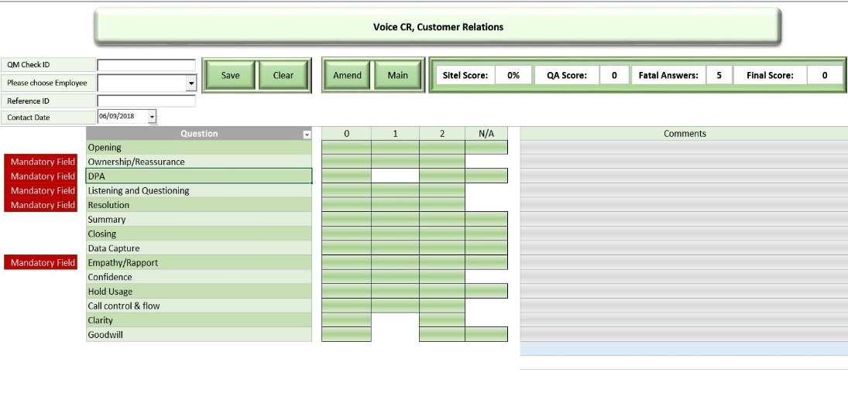
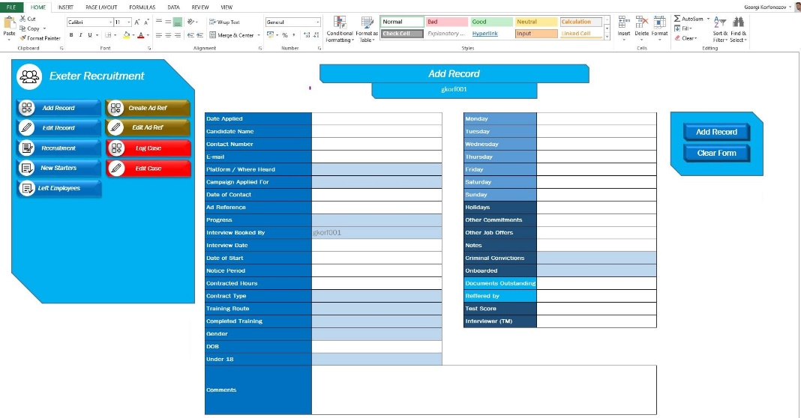
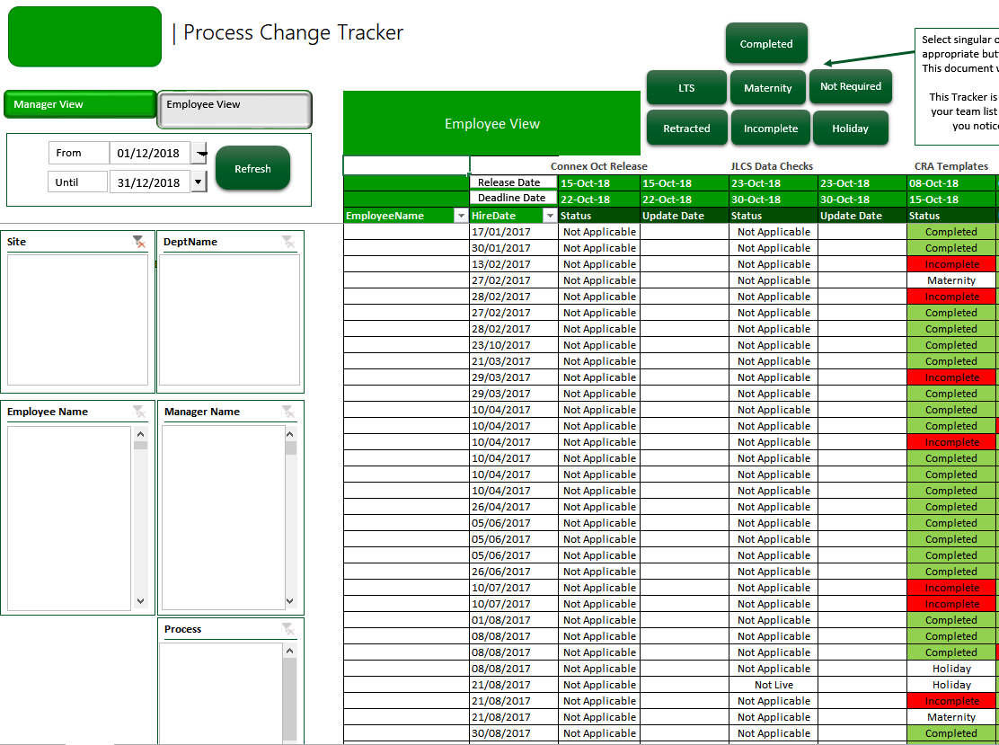
Tools Development
1. Process Change Tracker
3
A tool to track agents process training completion against training groups and target completion dates.
Newly applied and changed processes tracking
Intuitive and easy to use interface
3. Quality Management Tools
2
Easy to use Agent evaluation tool to monitor work quality and manage the team and campaign performance
Able to slice and track the individual and group performance with real-time reporting tool
Automation of the data to 2020
2. Recruitment Tool
Keeps records for each candidate, tracking their progress from job application to onboarding
Real-time custom reports by campaign, progress, recruiter etc.
1

Slide 14
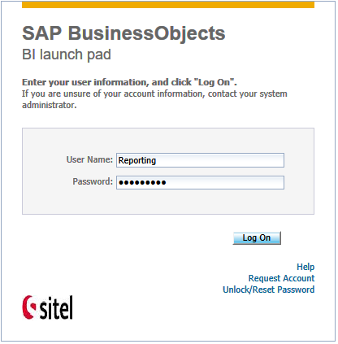
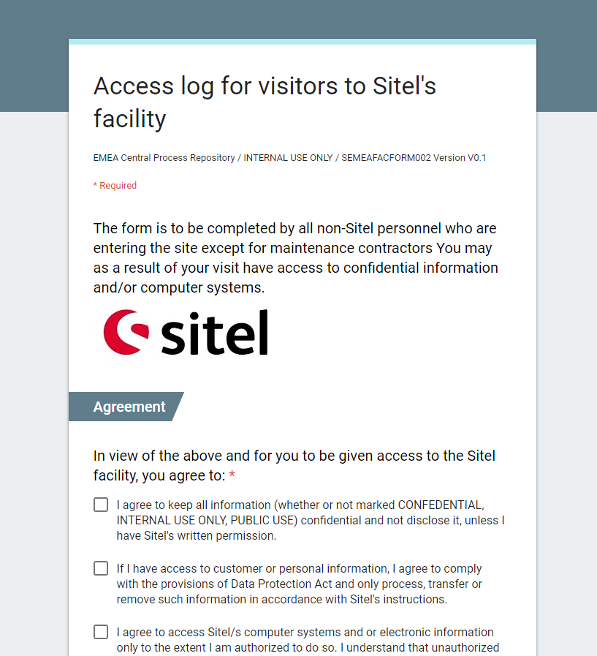
Site Support
2020 SKEP File Generation and Uploads
Creation of new reports in Business Objects
Visitors Registration Forms

